Slide 1
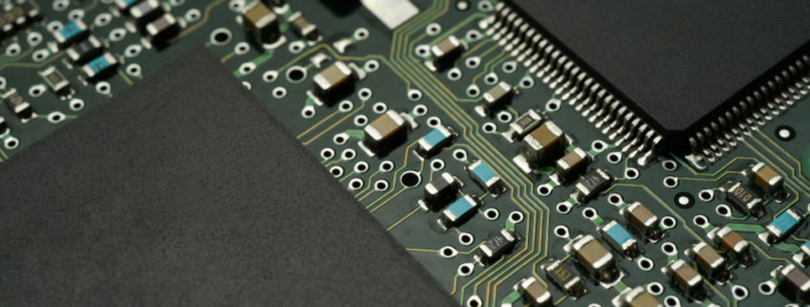
16 bit computer architecture
Created 12-20-2022

Slide 2
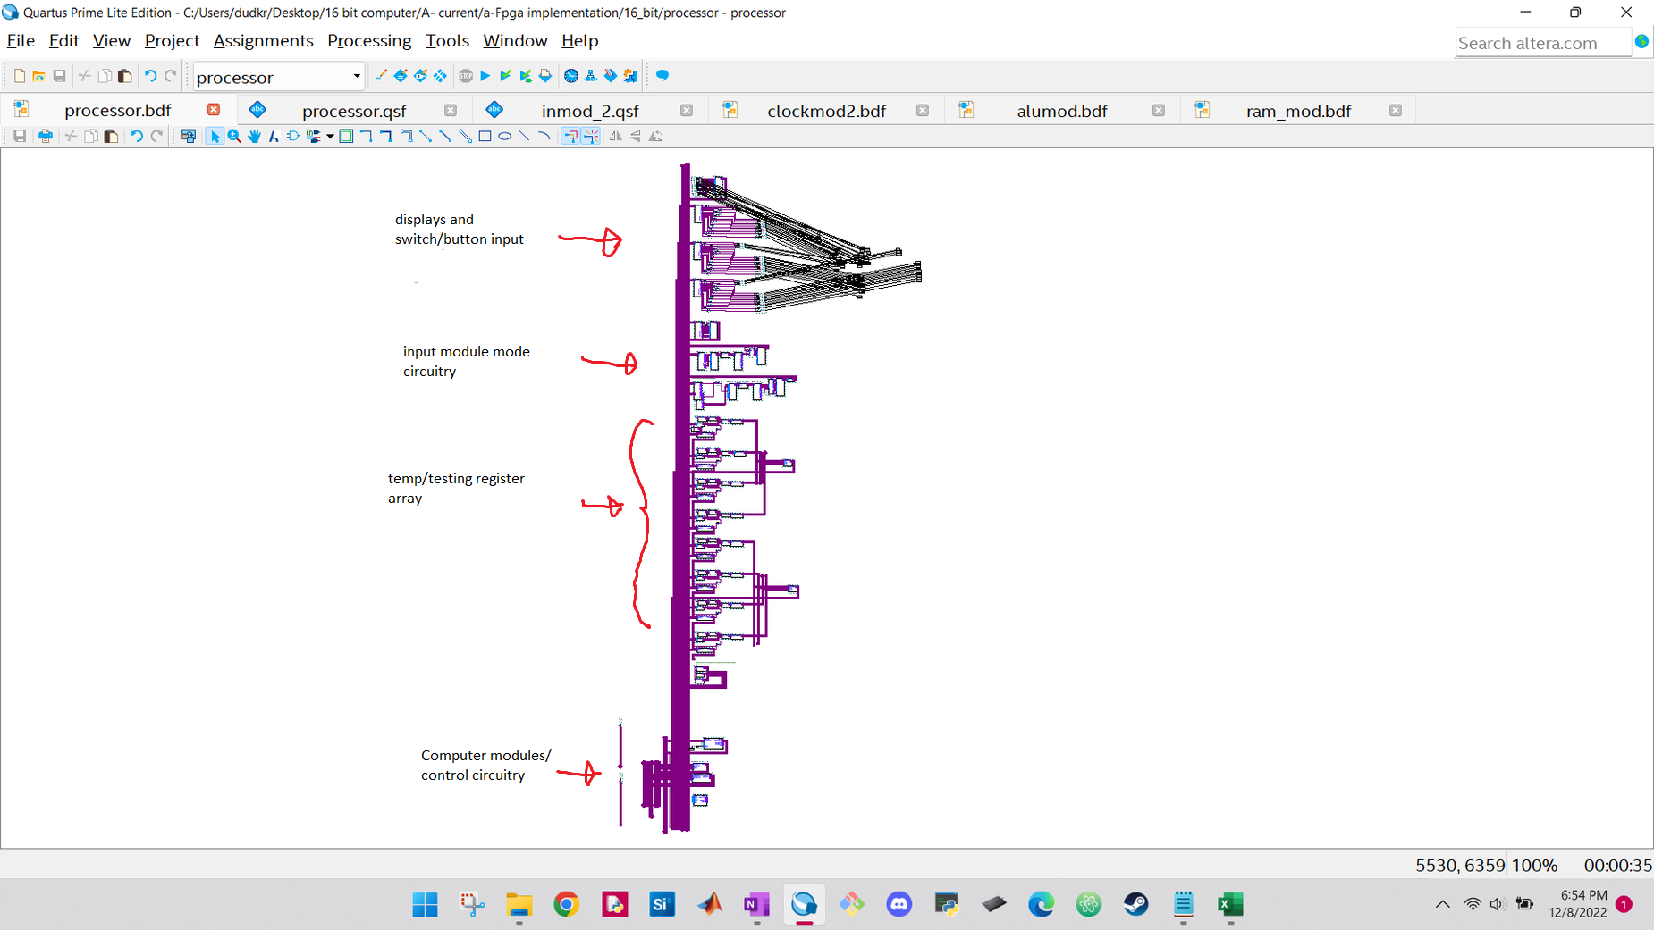
Big picture design

Slide 3
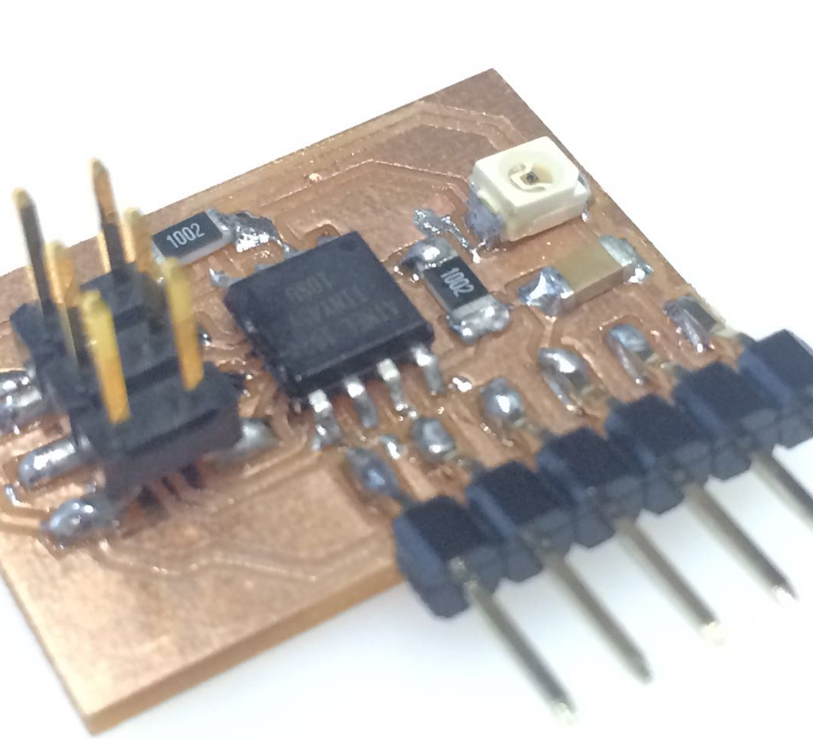
Input/output module
This Photo by Unknown author is licensed under CC BY-NC.

Slide 4

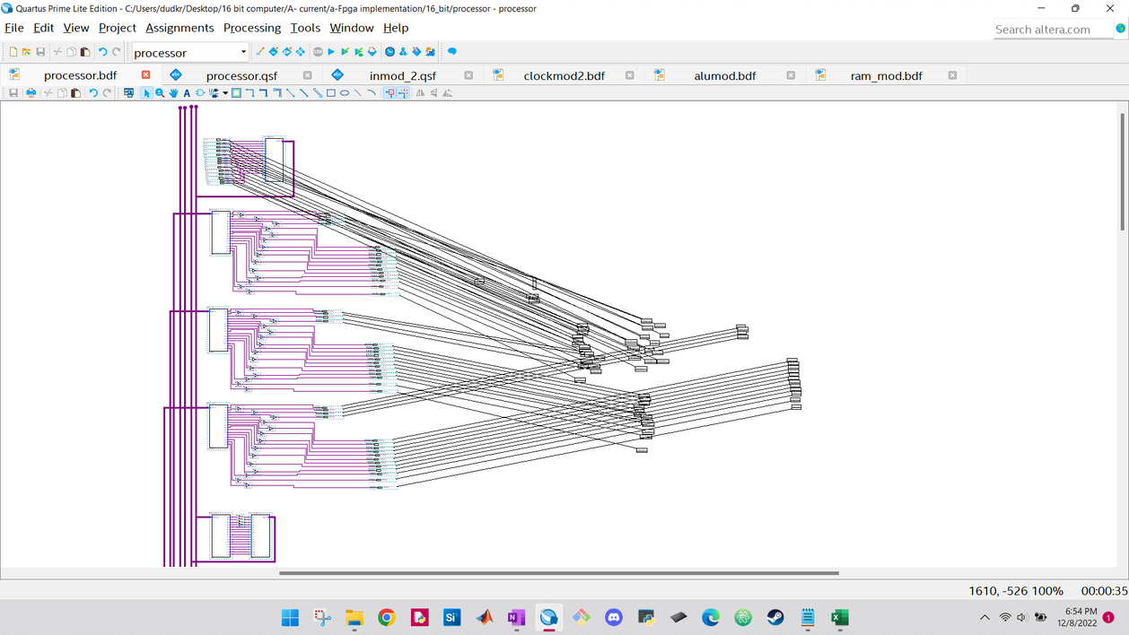
Input module closer look

Slide 5
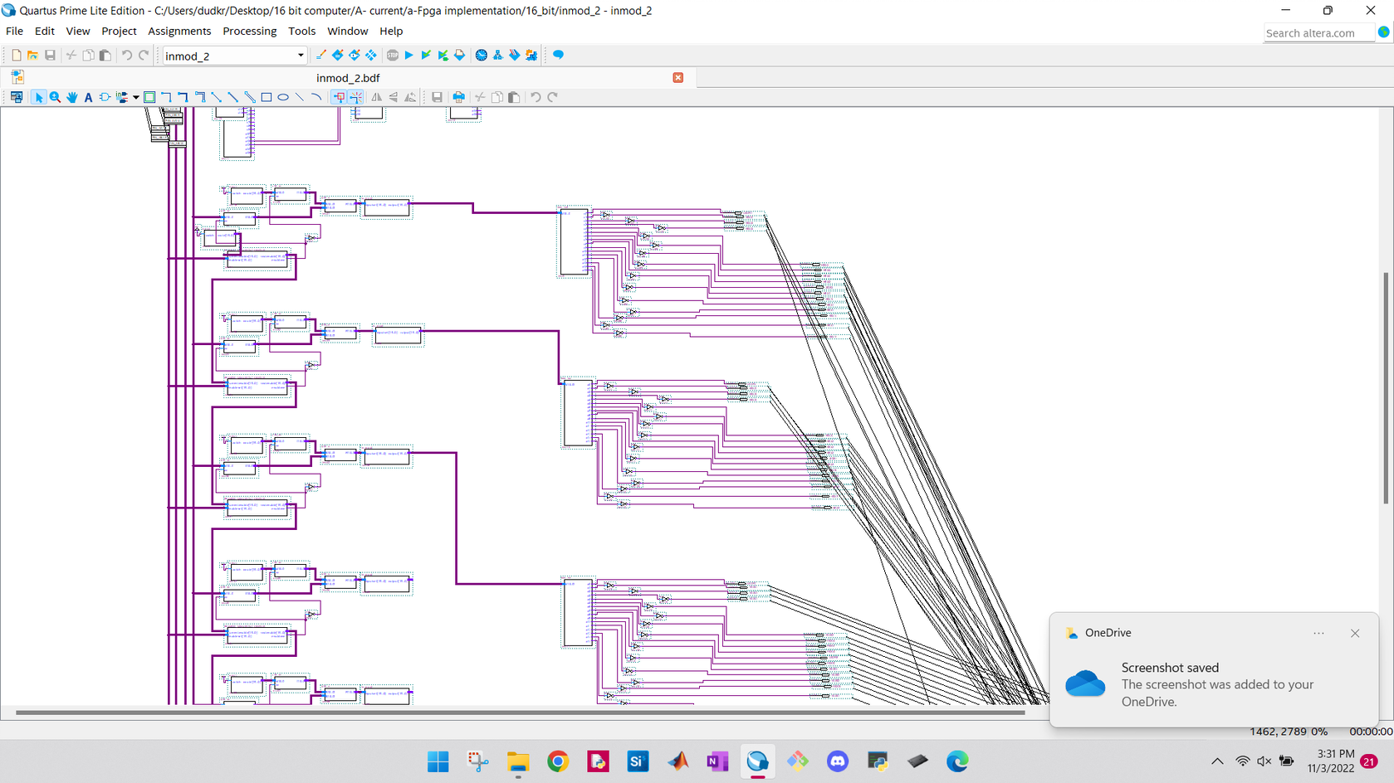
Big picture look at temp-registers

Slide 6
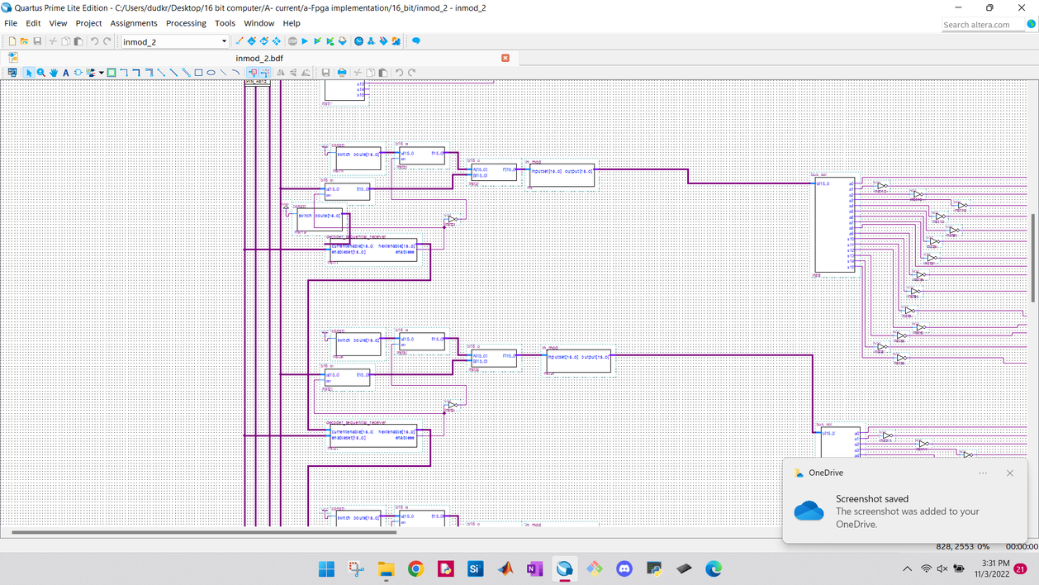

Slide 7
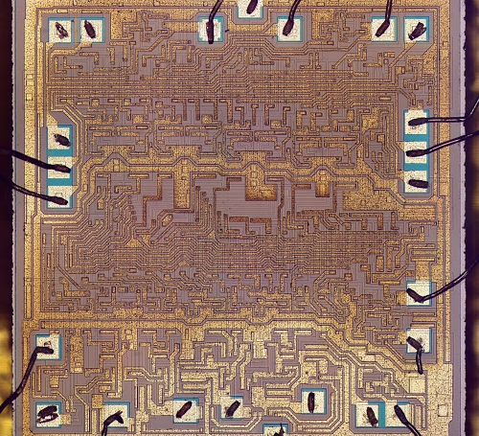
Alu
This Photo by Unknown author is licensed under CC BY-SA.

Slide 8
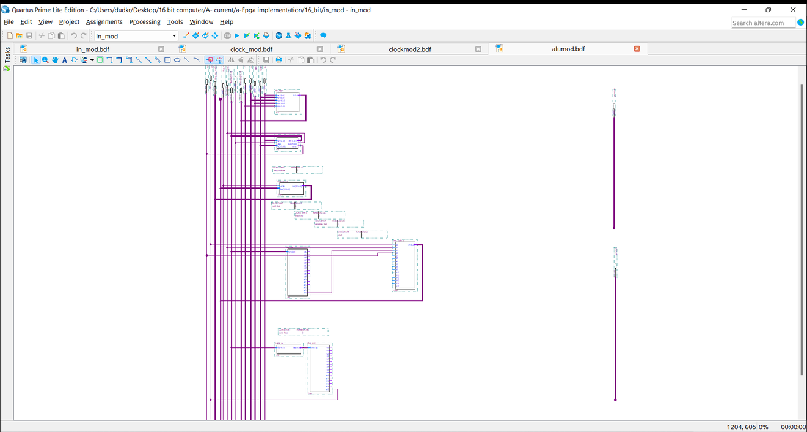



Bitwise operation circuitry
Big-picture design
Adder circuitry
Flag reg
Flag reg output
Zero flag

Slide 9
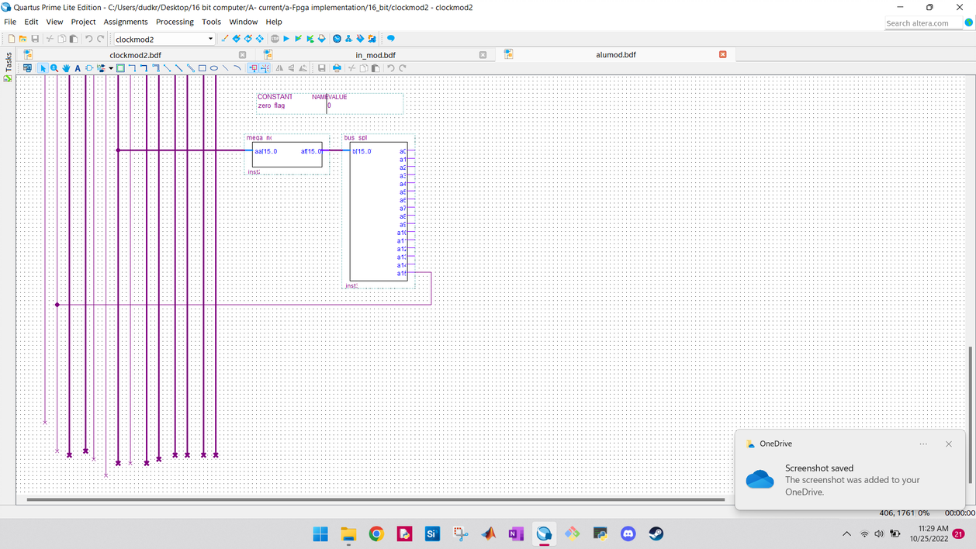
Zero flag
←

Slide 10
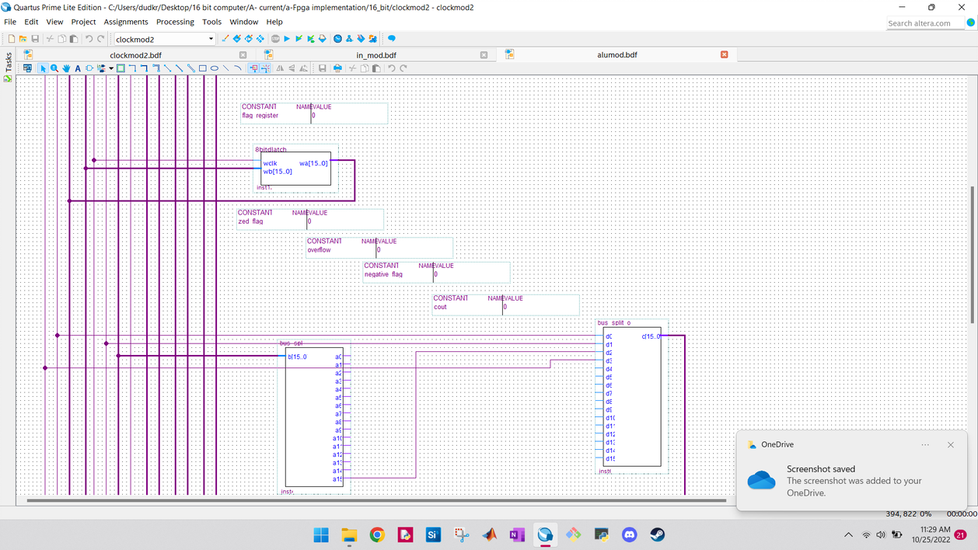
← Flag register circuitry
↓

Slide 11
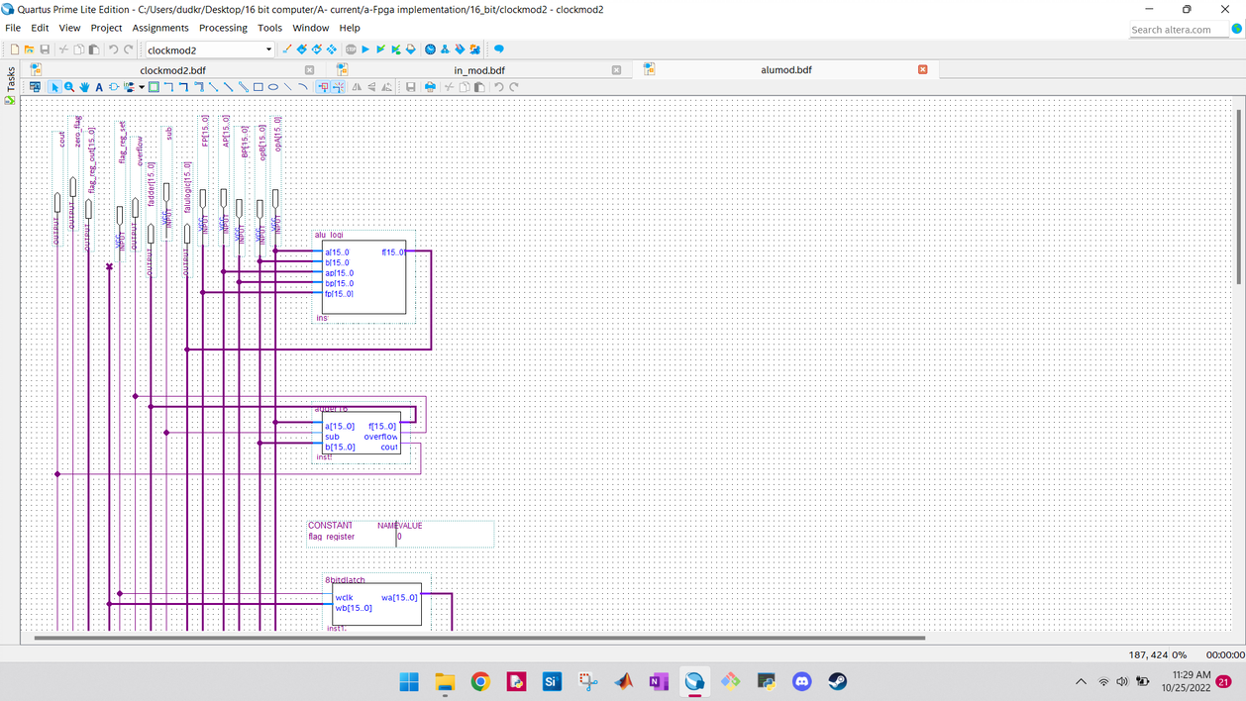
Adder and bitwise operation circuitry
← the ALU logic circuit is composed of 16 or gates which have XOR gates connected to their inputs and outputs. With the proper signaling, the circuit can perform any bitwise operation desired on two 16 bit inputs.

Slide 12
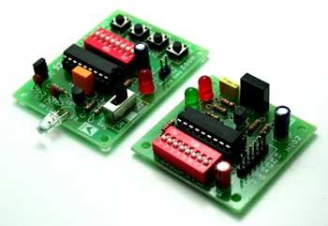
Decoder-receiver
This Photo by Unknown author is licensed under CC BY-SA.

Slide 13
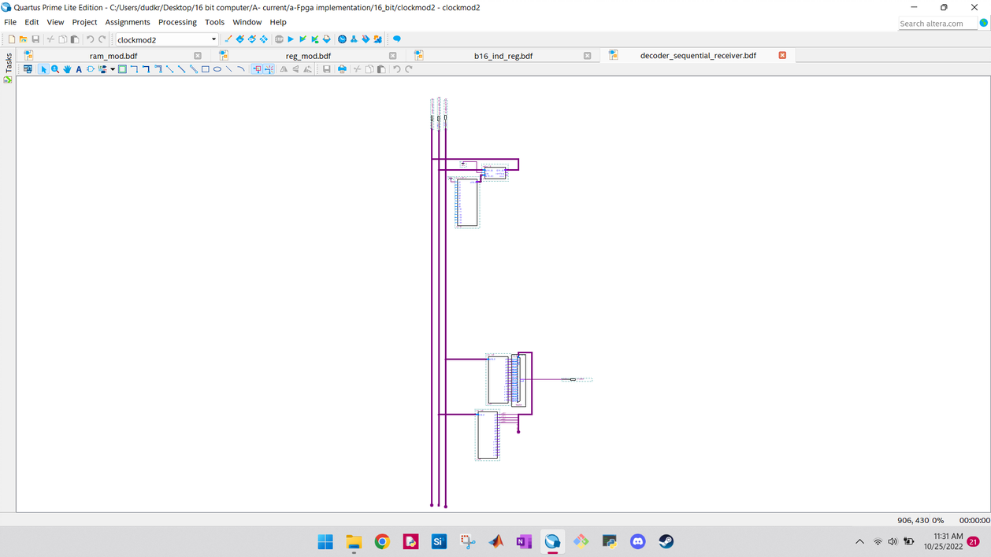


Decoder receiver big picture
The decoder receiver takes in
A 16 bit "current enable" value which indicates to the multiplexer which bit of the input set to return.
This allows recursive circuits to be fed the exact bit produced by a decoder, by daisy-chaining each individual circuit together.
Usage is seen in the input/ output module, and prominently in the register file.
Current enable adder
Input set multiplexer

Slide 14
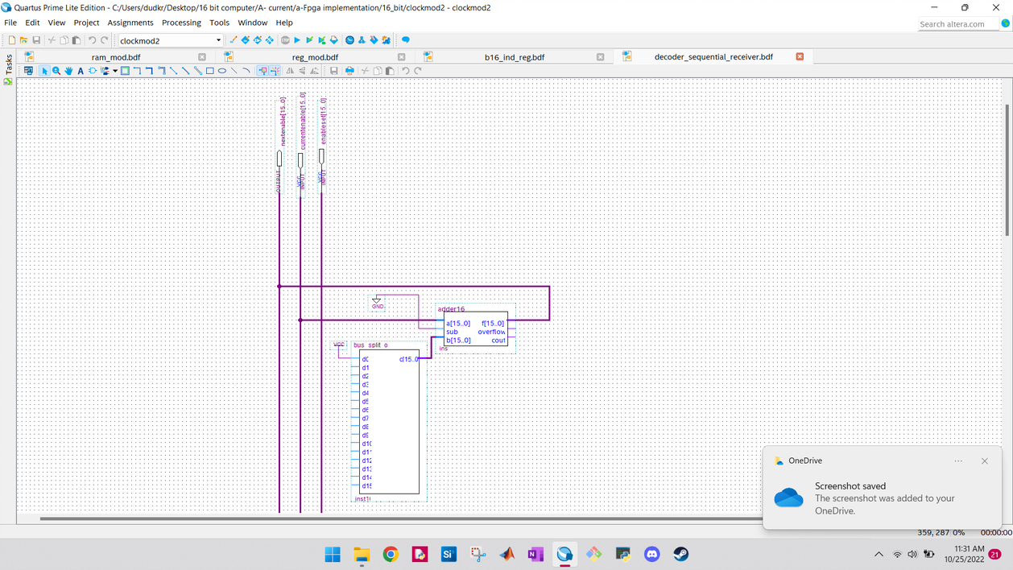

Slide 15
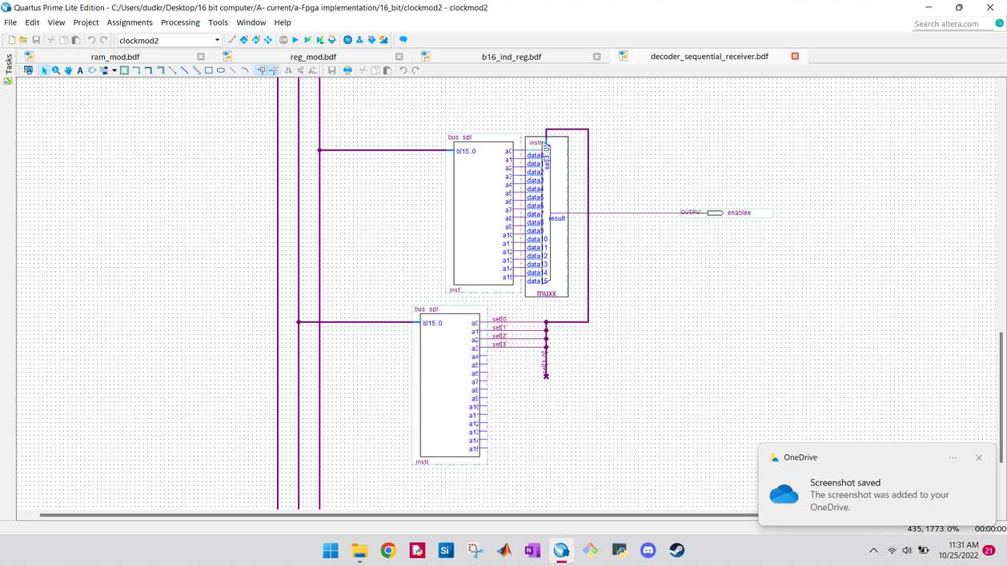

Slide 16

Register file
This Photo by Unknown author is licensed under CC BY-NC.

Slide 17
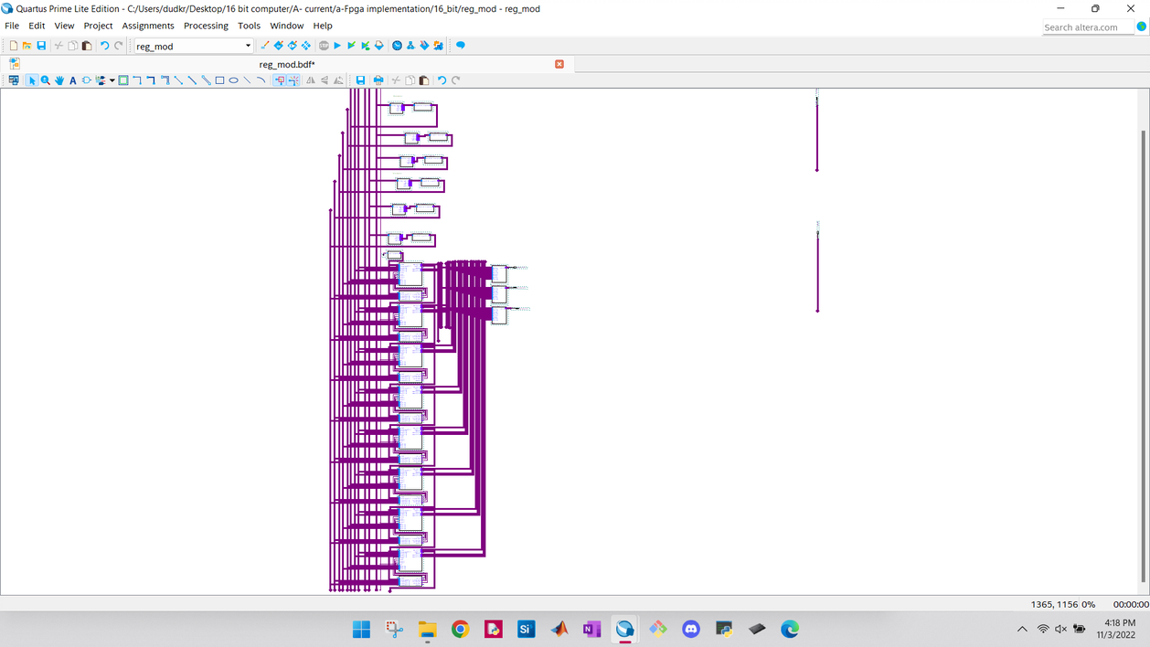
Register file big picture
Design

Slide 18
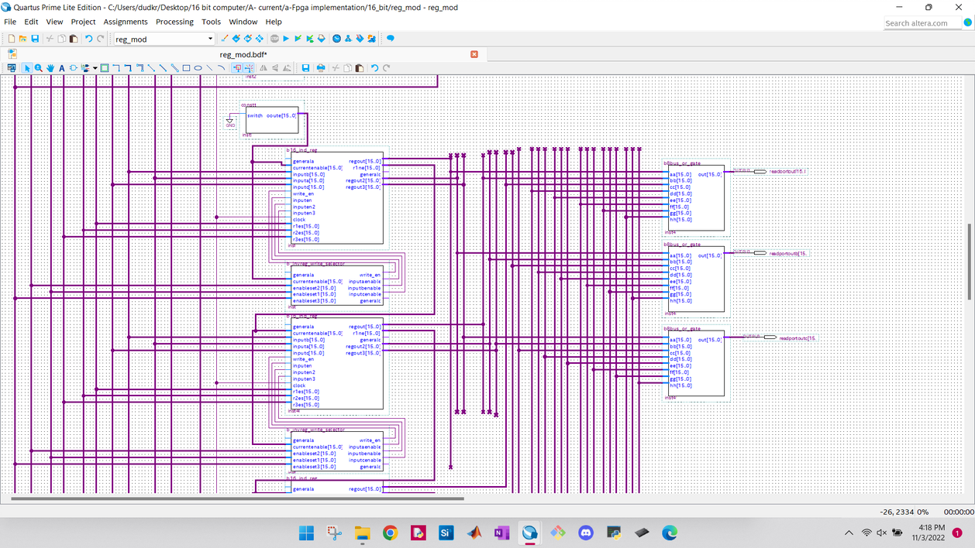
The register file features 8 registers, each having circuitry to handle three read and write ports.

Slide 19
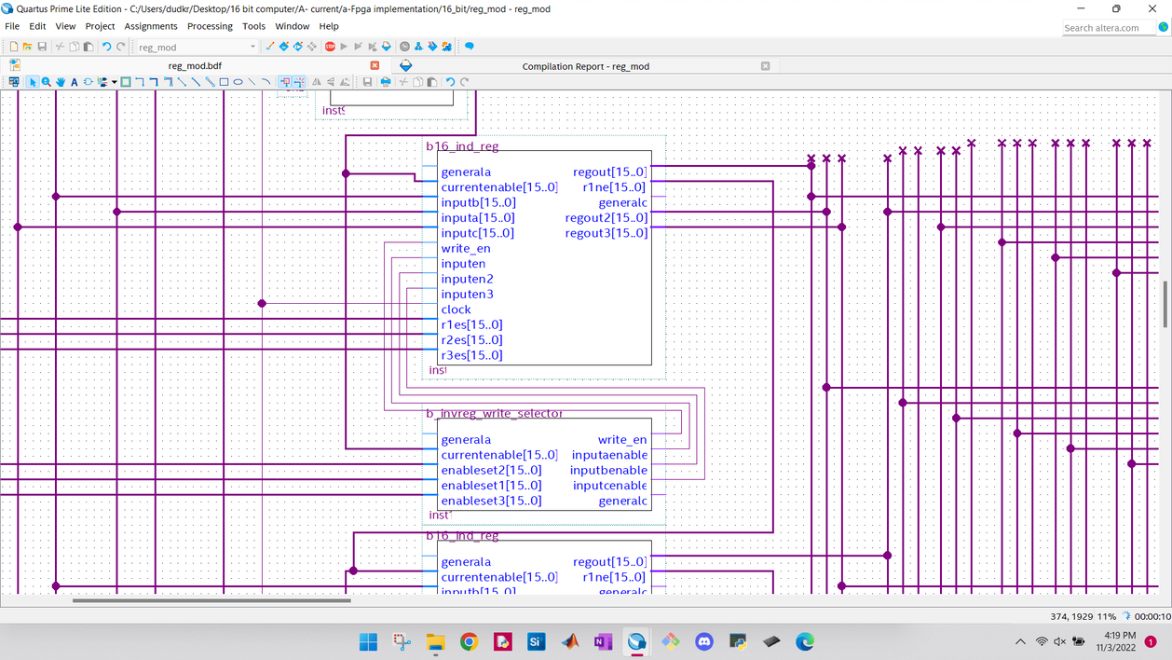
A closer look at the register connections

Slide 20
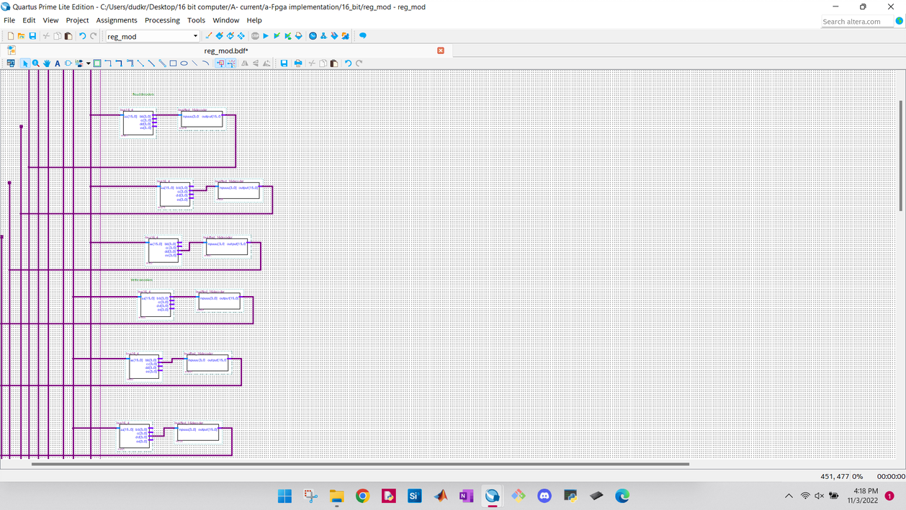
Decoders
The register file has three read and write decoders. Each decoder seen here outputs a 16 bit signal which indicates what register to active. Each register has a decoder input receiver which consists of a multiplexer to select the appropriate signal, and a 16 bit adder which informs the multiplexer the signal to parse out. As seen in the previous slides, each decoder receiver outputs its current value, which informs the next decoder receiver.

Slide 21
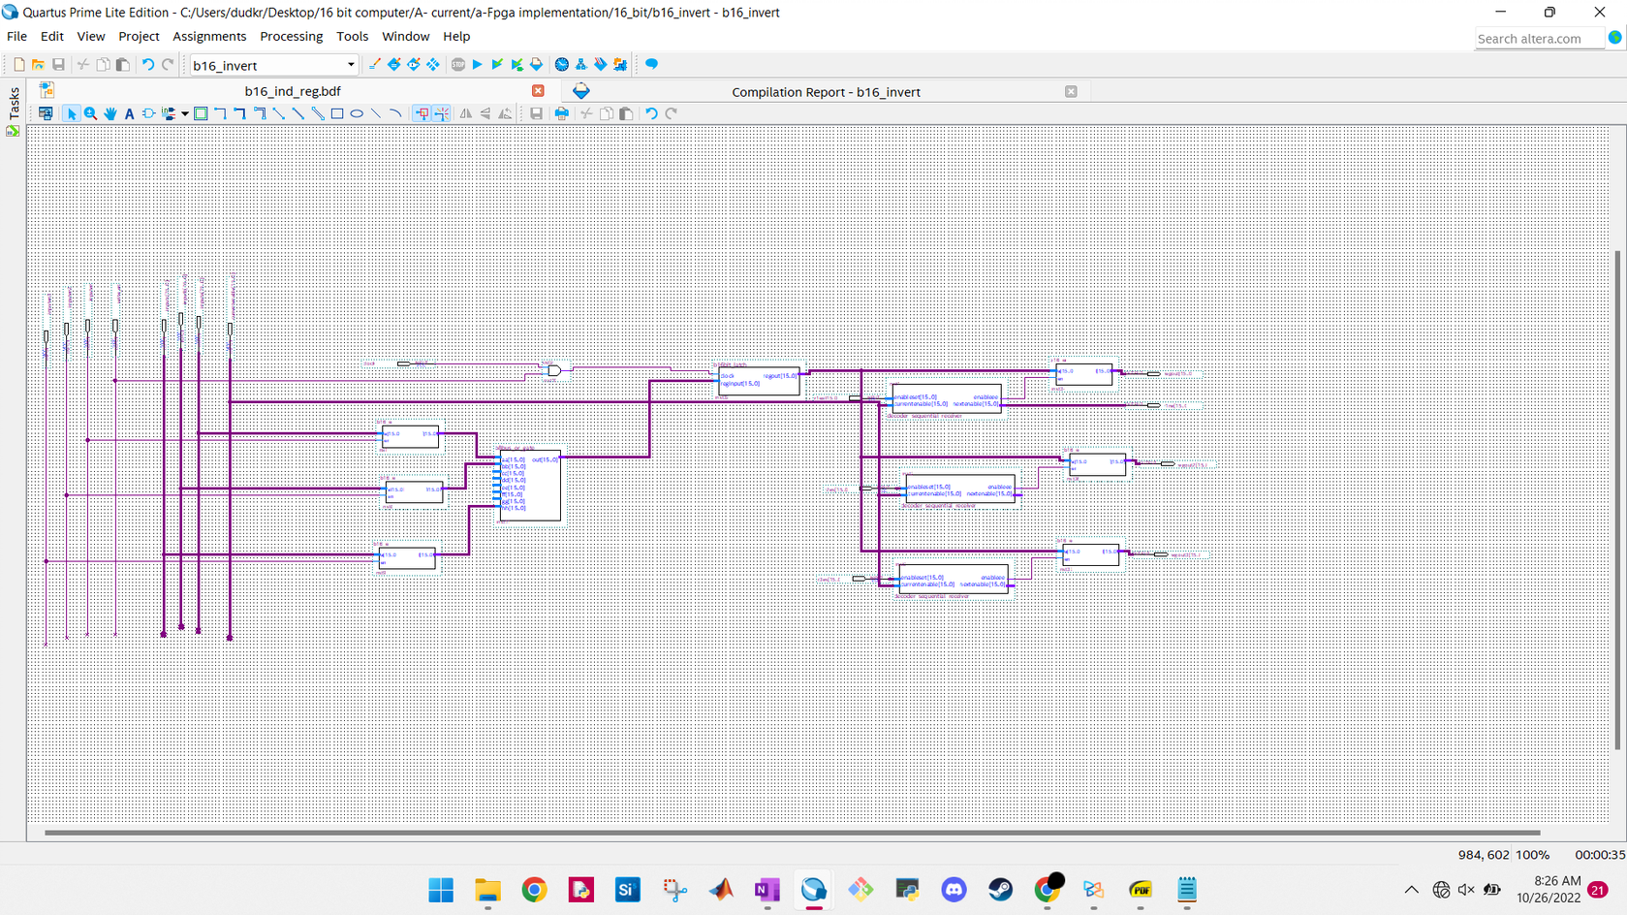
Big picture design of individual registers

Slide 22
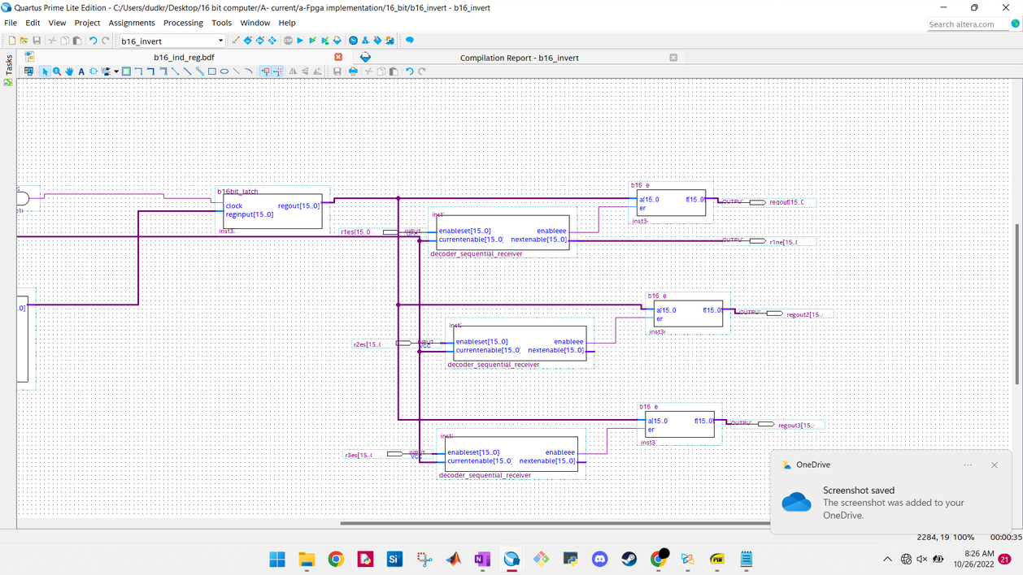
Output port circuitry

Slide 23
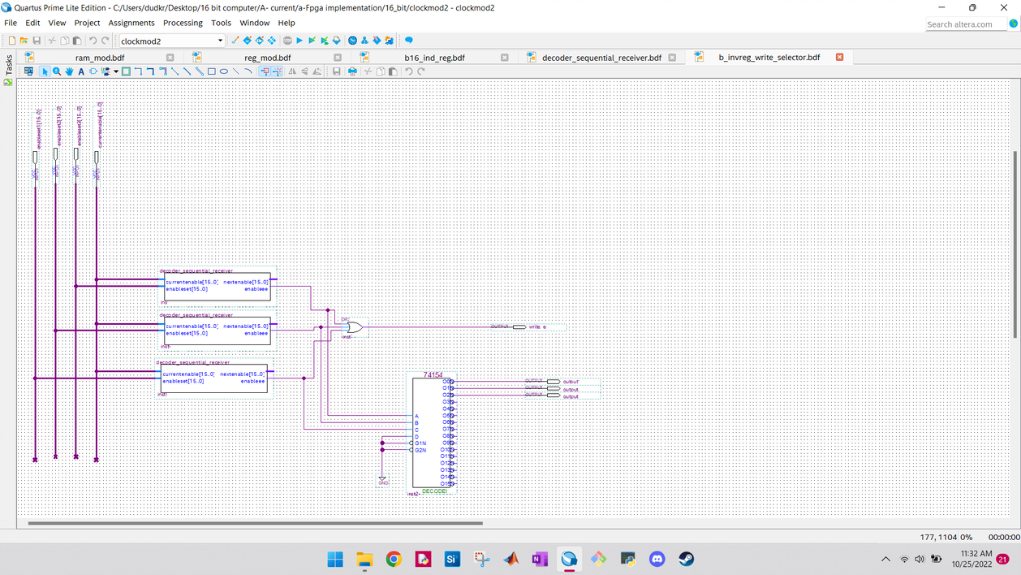
Register-write enable circuitry
If any write port selects a given register, the write enable signal is set high. The multiplexer informs the individual register which write port to take its input from
The individual register circuit is split up like this because quartus restricts the number of input and output signals you can have on any given circuit

Slide 24
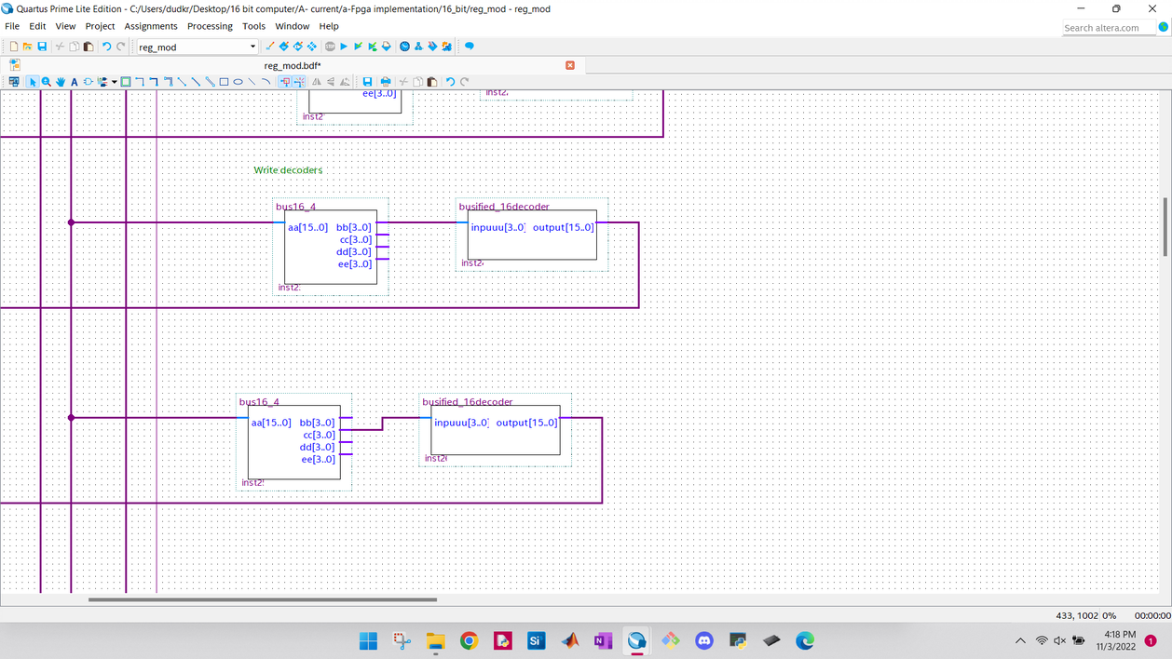

Slide 25
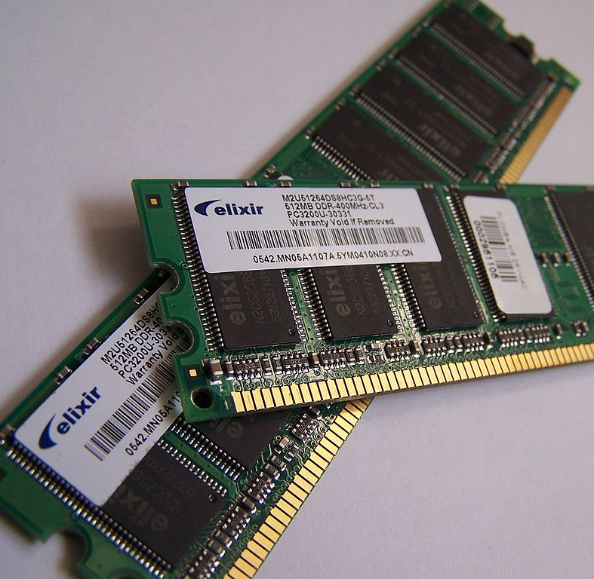
Ram module
This Photo by Unknown author is licensed under CC BY-NC-ND.

Slide 26
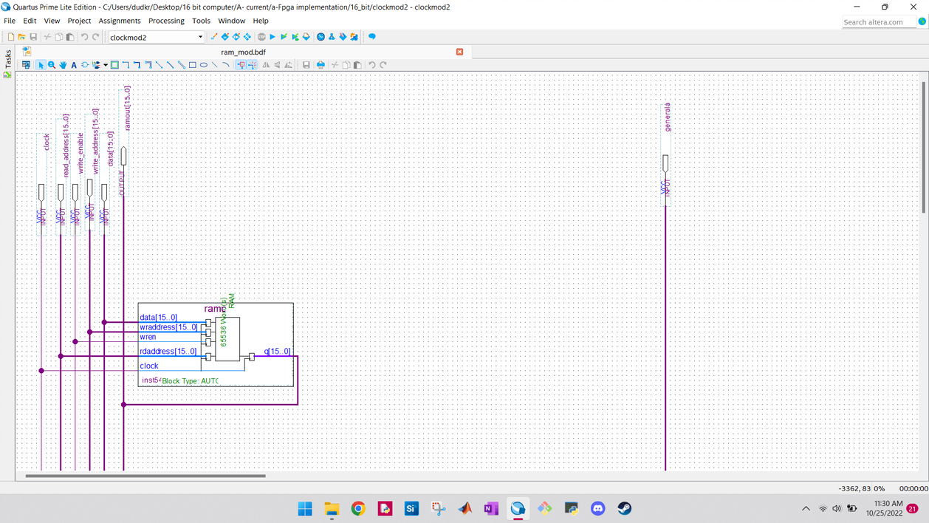

Slide 27
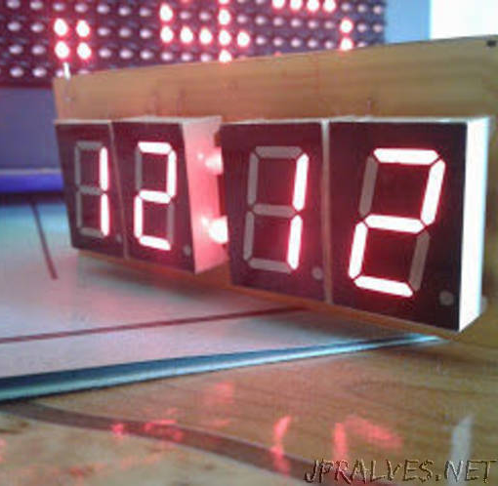
Clock module
This Photo by Unknown author is licensed under CC BY-NC-ND.

Slide 28
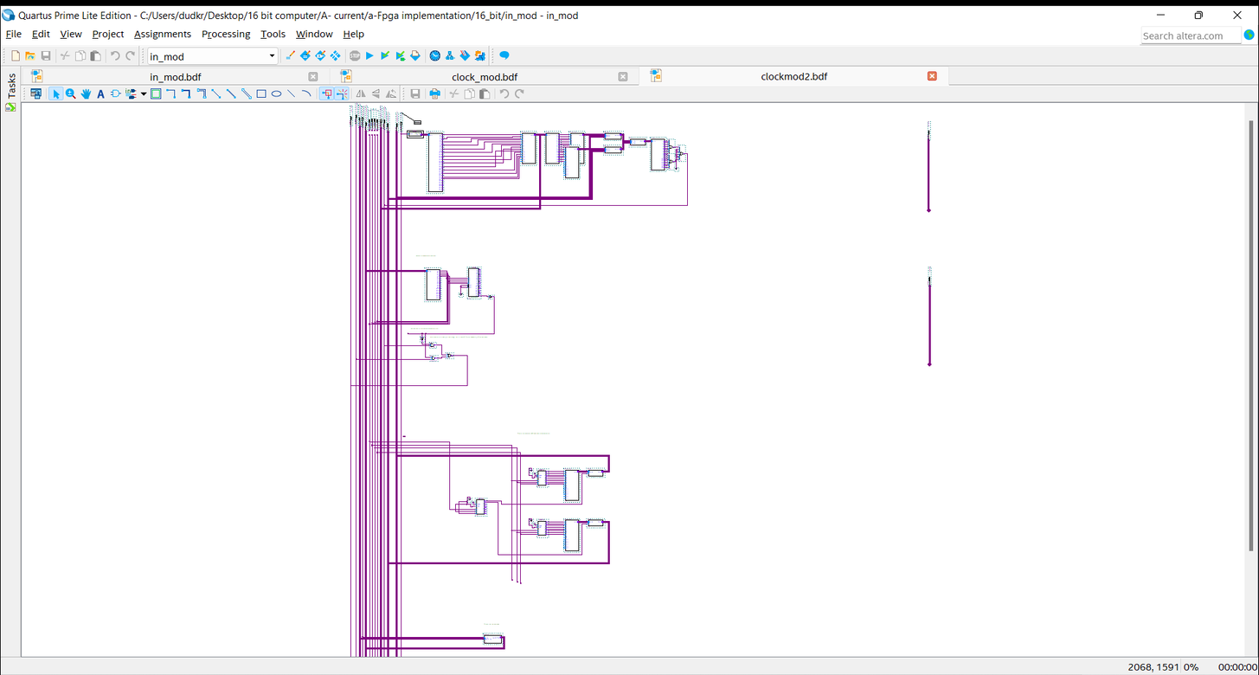




Frequency selection ORed output
Clock module big picture look
Manual clock signal
Selection circuit
Frequency code decoder
Selected frequency register

Slide 29
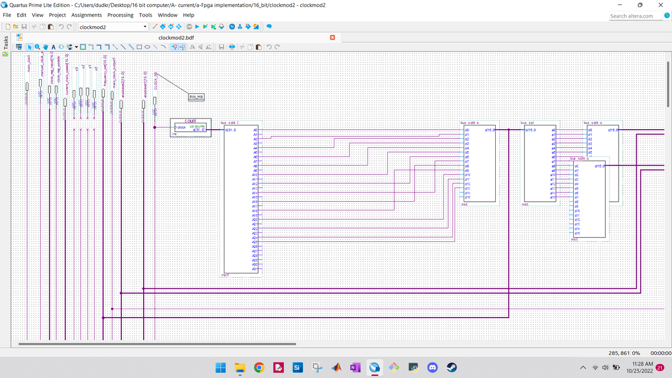
Frequency set is attached to or gates, and enabled through this circuitry

Slide 30
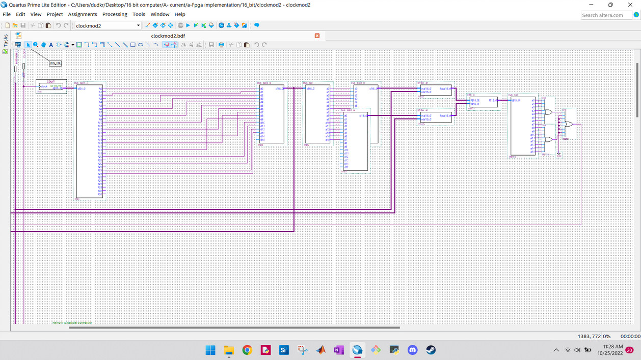

Slide 31
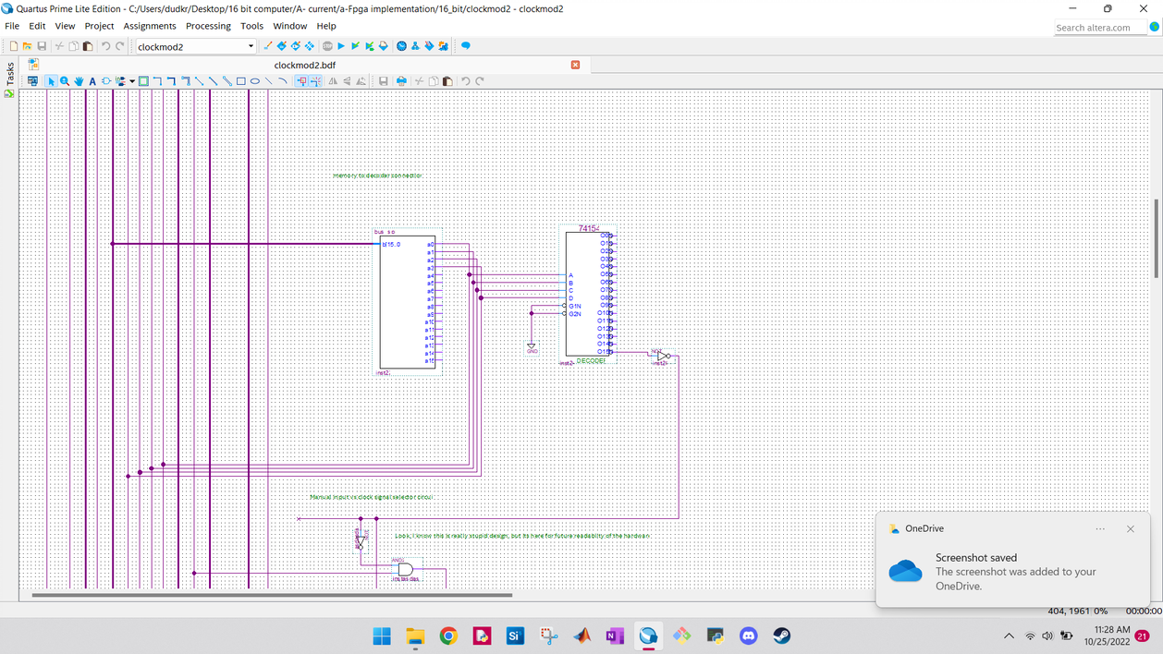
Manual frequency selection circuit

Slide 32
Questions? Comments? Concerns?
Please let me know at gaun8195@colorado.edu
If interested, project is located here
Thank you for your time

